Slide 1
SQL
AGGREGATE FUNCTIONS

Slide 2
AGGREGATE FUNCTIONS
Aggregate functions
For calculating and summarizing values in queries, SQL provides the following aggregate functions:
COUNT
SUM
AVG
MIN
MAX
Notes:
Functions SUM and AVG operate on numeric values only.

Slide 3
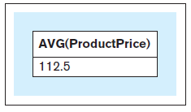
AGGREGATE FUNCTIONS
Query 12 text: Retrieve the average price of all products
Query 12 : SELECT AVG(productprice) FROM product;
Query 12 result:
Notes:
This example is discussed on Page 139.

Slide 4
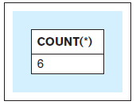
AGGREGATE FUNCTIONS
Query 13 text: Show how many products we offer for sale
Query 13 : SELECT COUNT(*) FROM product;
Query 13 result:
Notes:
This example is discussed on Page 139.

Slide 5
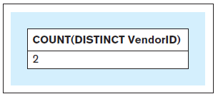
AGGREGATE FUNCTIONS
Query 14 text: Retrieve the number of vendors that supply our products
Query 14 : SELECT COUNT(DISTINCT vendorid) FROM product;
Query 14 result:
Notes:
This example is discussed on Page 140.

Slide 6
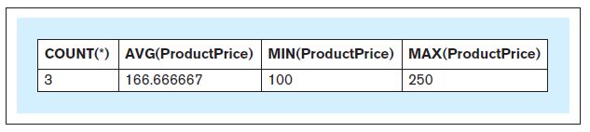
AGGREGATE FUNCTIONS
Query 15 text: Retrieve the number of products, average product price, lowest product price, and highest product price in the CP product category
Query 15 : SELECT COUNT(*), AVG(productprice), MIN(productprice), MAX(productprice) FROM product WHERE categoryid = 'CP';
Query 15 result:
Notes:
This example is discussed on Page 140.

Slide 7
GROUP BY
GROUP BY
Enables summarizations across the groups of related data within tables

Slide 8
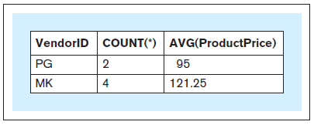
GROUP BY
Query 16 text: For each vendor, retrieve the vendor ID, number of products supplied by the vendor, and average price of the products supplied by the vendor
Query 16 : SELECT vendorid, COUNT(*), AVG(productprice) FROM product GROUP BY vendorid;
Query 16 result:
Notes:
This example is discussed on Pages 140-141.

Slide 9
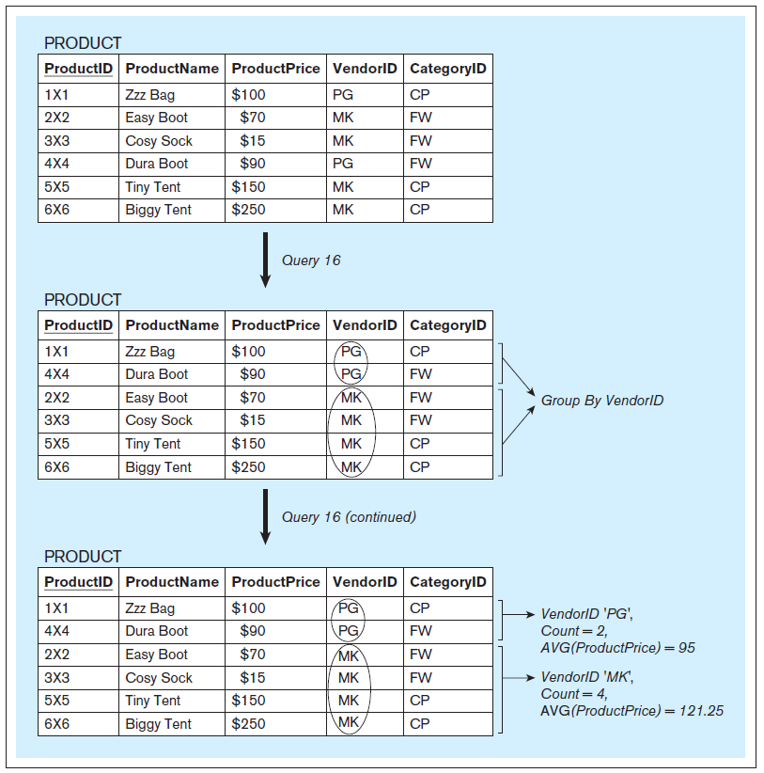
Query 16 illustration
Notes:
This example is discussed on Pages 140-141.

Slide 10
GROUP BY
Query 16 text: For each vendor, retrieve the vendor ID, number of products supplied by the vendor, and average price of the products supplied by the vendor
Query 16 : SELECT vendorid, COUNT(*), AVG(productprice) INVALID FROM product; ERROR MESSAGE RETURNED
Notes:
This example is discussed on Page 142.

Slide 11
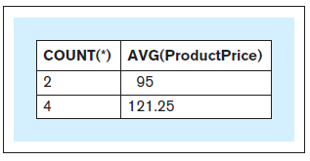
GROUP BY
Query 17 text: For each vendor, retrieve the number of products supplied by the vendor and the average price of the products supplied by the vendor
Query 17 : SELECT COUNT(*), AVG(productprice) FROM product GROUP BY vendorid;
Query 17 result (vs. Query 16):
Query 17 result
Query 16 result
Notes:
This example is discussed on Pages 142.

Slide 12
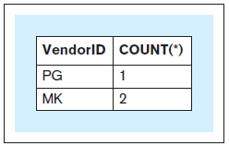
GROUP BY
Query 18 text: For each vendor, retrieve the vendor ID and the number of products with a product price of $100 or higher supplied by the vendor
Query 18 : SELECT vendorid, COUNT(*) FROM product WHERE productprice >= 100 GROUP BY vendorid;
Query 18 result:
Notes:
This example is discussed on Pages 142-143.

Slide 13
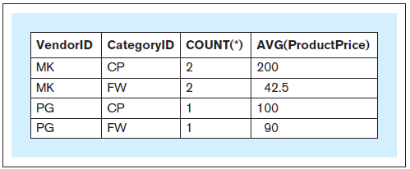
GROUP BY
Query 19 text: Consider the groups of products where each group contains the products that are from the same category supplied by the same vendor. For each such group, retrieve the vendor ID, product category ID, number of products in the group, and average price of the products in the group.
Query 19 : SELECT vendorid, categoryid, COUNT(*), AVG(productprice) FROM product GROUP BY vendorid, categoryid;
Query 19 result:
Notes:
This example is discussed on Page 143.

Slide 14
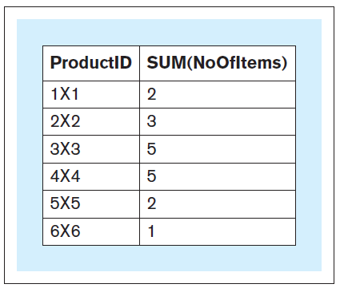
GROUP BY
Query 20 text: For each product, retrieve the ProductID value and the total number of product items sold within all sales transactions.
Query 20 : SELECT productid, SUM(noofitems) FROM soldvia GROUP BY productid;
Query 20 result:
Notes:
This example is discussed on Page 143.

Slide 15
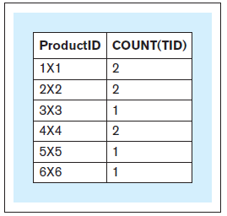
GROUP BY
Query 21 text: For each product, retrieve the ProductID value and the number of sales transactions in which the product was sold
Query 21: SELECT productid, COUNT(*) FROM soldvia GROUP BY productid;
Query 21 result:
Notes:
This example is discussed on Pages 143-144.

Slide 16
HAVING
HAVING
Enables summarizations across the groups of related data within tables
Determines which groups will be displayed in the result of a query and, consequently, which groups will not be displayed in the result of the query
A query that contains a HAVING clause must also contain a GROUP BY clause

Slide 17
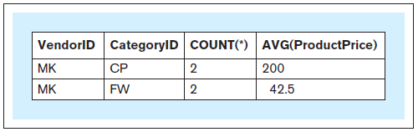
HAVING
Query 22 text: Consider the groups of products where each group contains the products that are from the same category and supplied by the same vendor. For each such group that has more than one product, retrieve the vendor ID, product category ID, number of products in the group, and average price of the products in the group.
Query 22: SELECT vendorid, categoryid, COUNT(*), AVG(productprice) FROM product GROUP BY vendorid, categoryid HAVING COUNT(*) > 1;
Query 22 result:
Notes:
This example is discussed on Page 144.

Slide 18
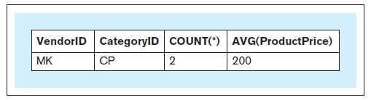
HAVING
Query 23 text: Consider the groups of products where each group contains the products that are from the same category, supplied by the same vendor, and whose product price is $50 or higher. For each such group that has more than one product, retrieve the vendor ID, product category ID, number of products in the group, and average price of the products.
Query 23: SELECT vendorid, categoryid, COUNT(*), AVG(productprice) FROM product WHERE productprice >= 50 GROUP BY vendorid, categoryid HAVING COUNT(*) > 1;
Query 23 result:
Notes:
This example is discussed on Pages 144-145.

Slide 19
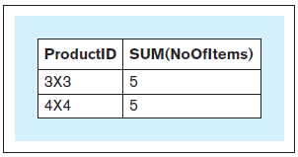
HAVING
Query 24 text: For each product that has more than three items sold within all sales transactions, retrieve the ProductID value and the total number of product items sold within all sales transactions
Query 24: SELECT productid, SUM(noofitems) FROM soldvia GROUP BY productid HAVING SUM(noofitems) > 3;
Query 24 result:
Notes:
This example is discussed on Page 145.

Slide 20
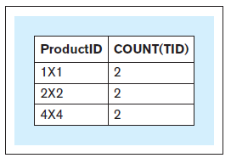
HAVING
Query 25 text: For each product that was sold in more than one sales transaction, retrieve the ProductID value and the number of sales transactions in which the product was sold
Query 25: SELECT productid, COUNT(*) FROM soldvia GROUP BY productid HAVING COUNT(*) > 1;
Query 25 result:
Notes:
This example is discussed on Page 145.

Slide 21
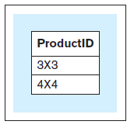
HAVING
Query 26 text: For each product that has more than three items sold within all sales transactions, retrieve the ProductID value
Query 26: SELECT productid FROM soldvia GROUP BY productid HAVING SUM(noofitems) > 3;
Query 26 result:
Notes:
This example is discussed on Page 146.

Slide 22
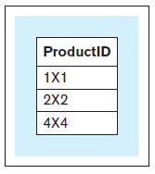
HAVING
Query 27 text: For each product that was sold in more than one sales transaction, retrieve the ProductID value
Query 27: SELECT productid FROM soldvia GROUP BY productid HAVING COUNT(*) > 1;
Query 27 result:
Notes:
This example is discussed on Page 146.

Slide 23
NESTED QUERIES
Nested Query
A query that is used within another query
A nested query is also referred to as an inner query,
The query that uses the nested query is referred to as an outer query
Notes:
A query may contain another query (or queries).

Slide 24
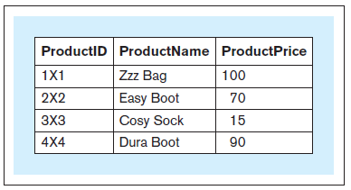
NESTED QUERIES
Query 28 text: For each product whose product price is below the average price of all products, retrieve the product ID, product name, and product price
Query 28: SELECT productid, productname, productprice FROM product WHERE productprice < ( SELECT AVG(productprice) FROM product);
Query 28 result:
Notes:
This example is discussed on Page 146.

Slide 25
NESTED QUERIES
Query 28 text: For each product whose product price is below the average price of all products, retrieve the product ID, product name, and product price
Query 28: SELECT productid, productname, productprice INVALID FROM product WHERE productprice < AVG(productprice);
Notes:
This example is discussed on Page 146-147.

Slide 26
IN
IN
Used for comparison of a value with a set of values

Slide 27
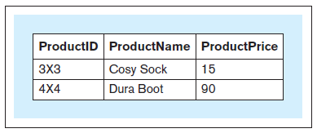
IN
Query 29 text: For each product that has more than three items sold within all sales transactions, retrieve the product ID, product name, and product price
Query 29: SELECT productid, productname, productprice FROM product WHERE productid IN (SELECT productid FROM soldvia GROUP BY productid HAVING SUM(noofitems) > 3);
Query 29 result:
Notes:
This example is discussed on Page 147.

Slide 28
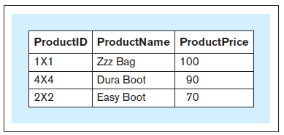
IN
Query 30 text: For each product whose items were sold in more than one sales transaction, retrieve the product id, product name and product price
Query 30 : SELECT productid, productname, productprice FROM product WHERE productid IN (SELECT productid FROM soldvia GROUP BY productid HAVING COUNT(*) > 1);
Query 30 result:
Notes:
This example is discussed on Pages 147-148.

Slide 29
ALIAS
Alias
An alternative and usually shorter name that can be used anywhere within a query instead of the full relation name
Notes:
Columns can also have aliases but their use is more restricted within a query.

Slide 30
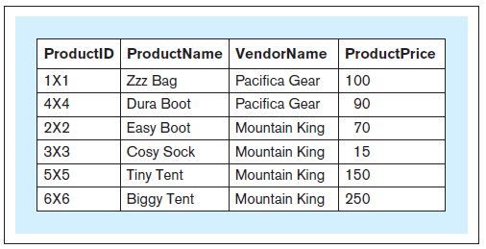
ALIAS
Query 31 text: For each product, retrieve the product ID, name of the product, name of the vendor of the product, and price of the product
Query 31: SELECT productid, productname, vendorname, productprice FROM product, vendor WHERE product.vendorid = vendor.vendorid;
Query 31 result:
Notes:
This example is discussed on Page 151.

Slide 31
ALIAS
Query 31a text: For each product, retrieve the product ID, name of the product, (same query) name of the vendor of the product, and price of the product
Query 31a: SELECT p.productid, p.productname, v.vendorname, p.productprice FROM product p, vendor v WHERE p.vendorid = v.vendorid;
Query 31a result: (same result)
Notes:
This example is discussed on Page 151.

Slide 32
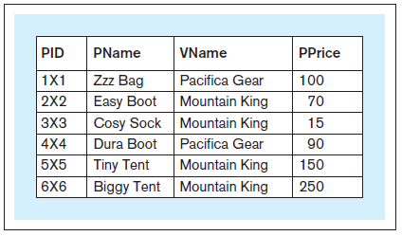
ALIAS
Query 31b text: For each product, retrieve the product id, name of the product, (same query) name of the vendor of the product, and price of the product
Query 31b: SELECT p.productid pid, p.productname pname, v.vendorname vname, p.productprice pprice FROM product p, vendor v WHERE p.vendorid = v.vendorid;
Query 31b result: (same result, different column names in the result)
Notes:
This example is discussed on Page 151.

Slide 33
ALIAS - AS
Query 31c text: For each product, retrieve the product id, name of the product, (same query) name of the vendor of the product, and price of the product
Query 31c: SELECT p.productid AS pid, p.productname AS pname, v.vendorname AS vname, p.productprice AS pprice FROM product p, vendor v WHERE p.vendorid = v.vendorid;
Query 31c result: (same result, as Query 31b)
Notes:
This example is discussed on Page 152.

Slide 34
DML
UPDATE

Slide 35
UPDATE - Used to modify the data stored in database relations
Insert Statement 1: INSERT INTO product VALUES ('7×7','Airy Sock',1000,'MK','CP');
Update Statement 1: UPDATE product SET productprice = 10 WHERE productid = '7×7';
Alter Statement 3: ALTER TABLE product ADD (discount NUMERIC(3,2) );
Update Statement 2: UPDATE product SET discount = 0.2;
Update Statement 3: UPDATE product SET discount = 0.3 WHERE vendorid = 'MK';
Alter Statement 4: ALTER TABLE product DROP (discount);
Notes:
This example is discussed on Pages 153-154.

Slide 36
DELETE
DELETE
Used to delete the data stored in database relations
Delete Statement 1:
DELETE FROM product WHERE productid = '7×7';

Slide 37
DELETE
Notes:
This example is discussed on Page 154.

Slide 38
VIEW
VIEW
Mechanism in SQL that allows the structure of a query to be saved in the RDBMS
Also known as a virtual table
View is not an actual table and does not have any data physically saved
Every time a view is invoked, it executes a query that retrieves the data from the actual tables
A view can be used in SELECT statements just like any other table from a database

Slide 39
VIEW
Create View Statement 1:
CREATE VIEW products_more_than_3_sold AS
SELECT productid, productname, productprice
FROM product
WHERE productid IN
(
SELECT productid
FROM soldvia
GROUP BY productid
HAVING SUM(noofitems) > 3
);
Notes:
This example is discussed on Pages 154-155.

Slide 40
VIEW
Query 29 text: For each product that has more than three items sold within all sales transactions, retrieve the product ID, product name, and product price
Query 29: SELECT productid, productname, productprice FROM product WHERE productid IN (SELECT productid FROM soldvia GROUP BY productid HAVING SUM(noofitems) > 3);
Query 29 result:
Notes:
This example is discussed on Pages 154-155.

Slide 41
VIEW
Query 29a text: For each product that has more than three items sold (same query) within all sales transactions, retrieve the product ID, product name, and product price
Query 29a: SELECT * FROM products_more_than_3_sold;
Query 29a result:
(same result)
Notes:
This example is discussed on Pages 154-155.

Slide 42
VIEW
Create View Statement 2:
CREATE VIEW products_in_multiple_trnsc AS SELECT productid, productname, productprice FROM product WHERE productid IN (SELECT productid FROM soldvia GROUP BY productid HAVING COUNT(*) > 1);
Notes:
This example is discussed on Page 155.

Slide 43
VIEW
Query 30 text: For each product whose items were sold in more than one sales transaction, retrieve the product name and product price
Query 30 : SELECT productid, productname, productprice FROM product WHERE productid IN (SELECT productid FROM soldvia GROUP BY productid HAVING COUNT(*) > 1);
Query 30 result:
Notes:
This example is discussed on Page 155.

Slide 44
VIEW
Query 30a text: For each product whose items were sold in more than one sales transaction, retrieve the product name and product price
Query 30a : SELECT * FROM products_in_multiple_trnsc;
Query 30a result:
(same result)
Notes:
This example is discussed on Page 155.

Slide 45
SET OPERATORS
Set operators
Standard set operators: union, intersection, and difference
Used to combine the results of two or more SELECT statements that are union compatible
Two sets of columns are union compatible if they contain the same number of columns, and if the data types of the columns in one set match the data types of the columns in the other set
The first column in one set has a compatible data type with the data type of the first column in the other set, the second column in one set has a compatible data type with the data type of the second column in the other set, and so on.
The set operators can combine results from SELECT statements querying relations, views, or other SELECT queries.

Slide 46
SET OPERATORS
UNION
Used to combine the union compatible results of two SELECT statements by listing all rows from the result of the first SELECT statement and all rows from the result of the other SELECT statement
If two or more rows are identical only one of them is shown (duplicates are eliminated from the result)

Slide 47
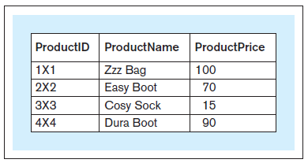
SET OPERATORS
Query 36 text: Retrieve the product ID, product name, and product price for each product that has more than three items sold within all sales transactions or whose items were sold in more than one sales transaction
Query 36: SELECT * FROM products_more_than_3_sold UNION SELECT * FROM products_in_multiple_trnsc;
Query 36 result:
Notes:
This example is discussed on Pages 155-156.

Slide 48
SET OPERATORS
INTERSECT
Used to combine the results of two SELECT statements that are union compatible by listing every row that appears in the result of both of the SELECT statements

Slide 49
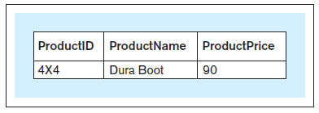
SET OPERATORS
Query 37 text: Retrieve the product ID, product name, and product price for each product that has more than three items sold within all sales transactions and whose items were sold in more than one sales transaction
Query 37: SELECT * FROM products_more_than_3_sold INTERSECT SELECT * FROM products_in_multiple_trnsc;
Query 37 result:
Notes:
This example is discussed on Page 156.

Slide 50
SET OPERATORS
MINUS (EXCEPT)
Used to combine the results of two SELECT statements that are union compatible by listing every row from the result of the first SELECT statement that does not appear in the result of the other SELECT statement

Slide 51
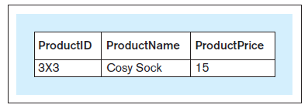
SET OPERATORS
Query 38 text: Retrieve the product ID, product name, and product price for each product that has more than three items sold within all sales transactions but whose items were not sold in more than one sales transaction
Query 38: SELECT * FROM products_more_than_3_sold MINUS SELECT * FROM products_in_multiple_trnsc;
Query 38 result:
Notes:
This example is discussed on Pages 156-157.

Slide 52
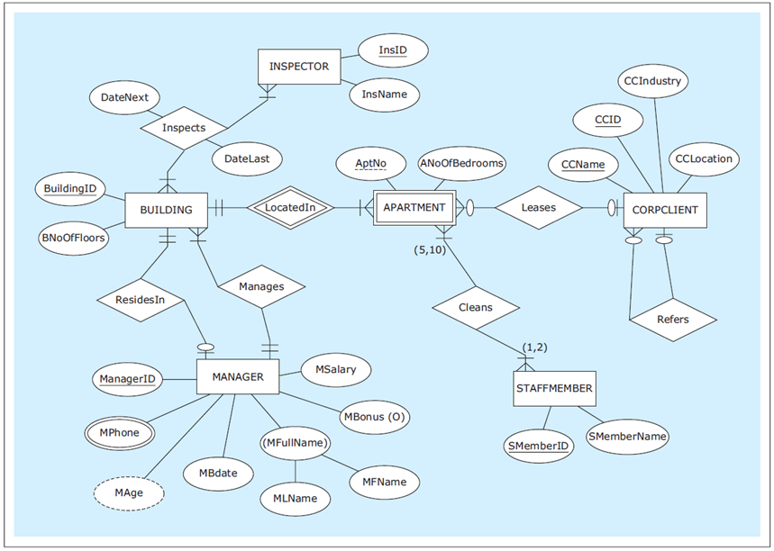
ER diagram: HAFH Realty Company Property Management Database
Notes:
This example is discussed on Pages 157-163.

Slide 53
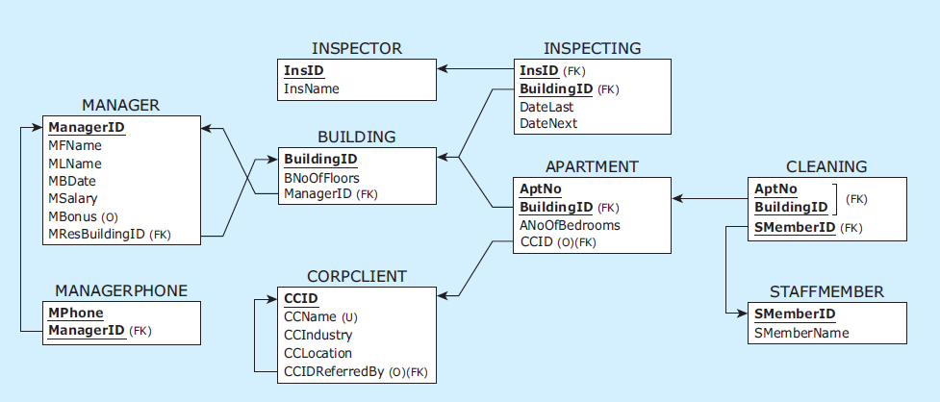
Relational schema: HAFH Realty Company Property Management Database
Notes:
This example is discussed on Pages 157-163.

Slide 54
CREATE TABLE statements for HAFH Realty Company Property Management Database
CREATE TABLE manager
( managerid CHAR(4) NOT NULL,
mfname VARCHAR(15) NOT NULL,
mlname VARCHAR(15) NOT NULL,
mbdate DATE NOT NULL,
msalary NUMERIC(9,2) NOT NULL,
mbonus NUMERIC(9,2),
mresbuildingid CHAR(3),
PRIMARY KEY (managerid) );
CREATE TABLE managerphone
( managerid CHAR(4) NOT NULL,
mphone CHAR(11) NOT NULL,
PRIMARY KEY (managerid, mphone),
FOREIGN KEY (managerid) REFERENCES manager(managerid) );
CREATE TABLE building
( buildingid CHAR(3) NOT NULL,
bnooffloors INT NOT NULL,
bmanagerid CHAR(4) NOT NULL,
PRIMARY KEY (buildingid),
FOREIGN KEY (bmanagerid) REFERENCES manager(managerid) );
Notes:
This example is discussed on Pages 157-163.

Slide 55
CREATE TABLE statements for HAFH Realty Company Property Management Database
CREATE TABLE inspector
( insid CHAR(3) NOT NULL,
insname VARCHAR(15) NOT NULL,
PRIMARY KEY (insid) );
CREATE TABLE inspecting
( insid CHAR(3) NOT NULL,
buildingid CHAR(3) NOT NULL,
datelast DATE NOT NULL,
datenext DATE NOT NULL,
PRIMARY KEY (insid, buildingid),
FOREIGN KEY (insid) REFERENCES inspector(insid),
FOREIGN KEY (buildingid) REFERENCES building(buildingid) );
CREATE TABLE corpclient
( ccid CHAR(4) NOT NULL,
ccname VARCHAR(25) NOT NULL,
ccindustry VARCHAR(25) NOT NULL,
cclocation VARCHAR(25) NOT NULL,
ccidreferredby CHAR(4),
PRIMARY KEY (ccid),
UNIQUE (ccname),
FOREIGN KEY (ccidreferredby) REFERENCES corpclient(ccid) );
Notes:
This example is discussed on Pages 157-163.

Slide 56
CREATE TABLE statements for HAFH Realty Company Property Management Database
CREATE TABLE apartment
( buildingid CHAR(3) NOT NULL,
aptno CHAR(5) NOT NULL,
anoofbedrooms INT NOT NULL,
ccid CHAR(4),
PRIMARY KEY (buildingid, aptno),
FOREIGN KEY (buildingid) REFERENCES building(buildingid),
FOREIGN KEY (ccid) REFERENCES corpclient(ccid) );
CREATE TABLE staffmember
( smemberid CHAR(4) NOT NULL,
smembername VARCHAR(15) NOT NULL,
PRIMARY KEY (smemberid) );
CREATE TABLE cleaning
( buildingid CHAR(3) NOT NULL,
aptno CHAR(5) NOT NULL,
smemberid CHAR(4) NOT NULL,
CONSTRAINT cleaningpk PRIMARY KEY (buildingid, aptno, smemberid),
CONSTRAINT cleaningfk1 FOREIGN KEY (buildingid, aptno)
REFERENCES apartment(buildingid, aptno),
CONSTRAINT cleaningfk2 FOREIGN KEY (smemberid)
REFERENCES staffmember(smemberid) );
Notes:
This example is discussed on Pages 157-163.

Slide 57
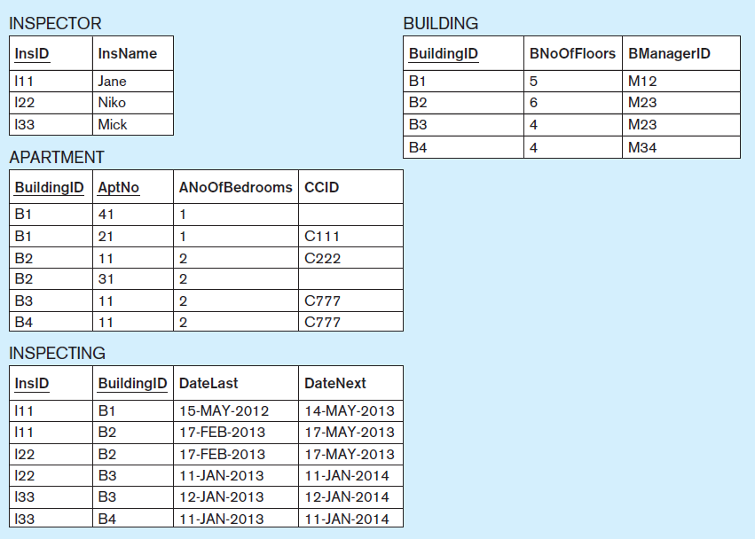
Data records: HAFH Realty Company Property Management Database (part 1)
Notes:
This example is discussed on Pages 157-163.

Slide 58
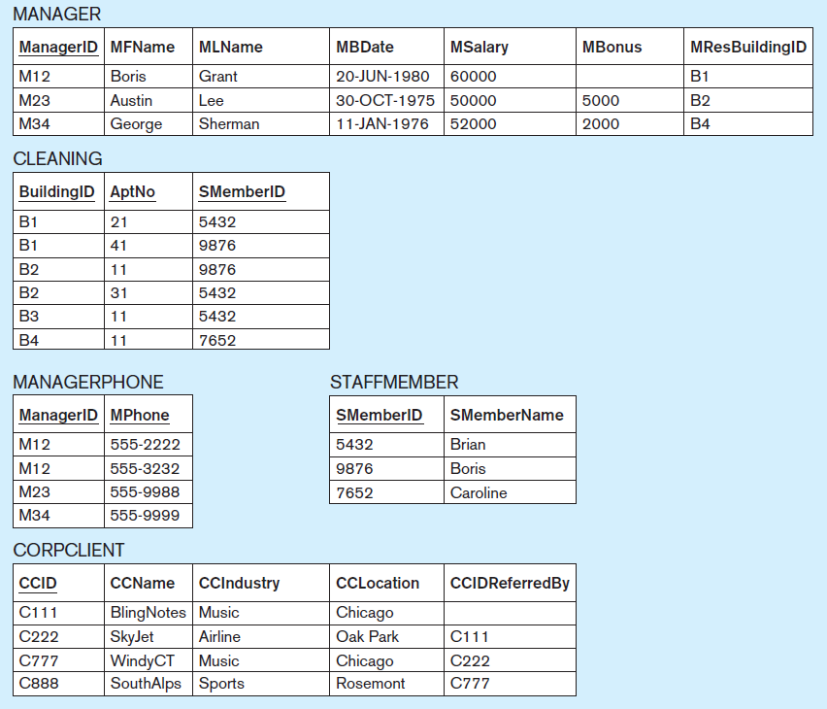
Data records: HAFH Realty Company Property Management Database (part 2)
Notes:
This example is discussed on Pages 157-163.

Slide 59
INSERT INTO statements for HAFH Realty Company Property Management Database
INSERT INTO manager VALUES ('M12', 'Boris', 'Grant', '20/Jun/1980', 60000, null, null);
INSERT INTO manager VALUES ('M23', 'Austin', 'Lee', '30/Oct/1975', 50000, 5000, null);
INSERT INTO manager VALUES ('M34', 'George', 'Sherman', '11/Jan/1976', 52000, 2000, null);
INSERT INTO managerphone VALUES ('M12','555-2222');
INSERT INTO managerphone VALUES ('M12','555-3232');
INSERT INTO managerphone VALUES ('M23','555-9988');
INSERT INTO managerphone VALUES ('M34','555-9999');
INSERT INTO building VALUES ('B1', '5', 'M12');
INSERT INTO building VALUES ('B2', '6', 'M23');
INSERT INTO building VALUES ('B3', '4', 'M23');
INSERT INTO building VALUES ('B4', '4', 'M34');
INSERT INTO inspector VALUES ('I11', 'Jane');
INSERT INTO inspector VALUES ('I22', 'Niko');
INSERT INTO inspector VALUES ('I33', 'Mick');
INSERT INTO inspecting VALUES ('I11','B1','15/May/2012','14/May/2013');
INSERT INTO inspecting VALUES ('I11','B2','17/Feb/2013','17/May/2013');
INSERT INTO inspecting VALUES ('I22','B2','17/Feb/2013','17/May/2013');
INSERT INTO inspecting VALUES ('I22','B3','11/Jan/2013','11/Jan/2014');
INSERT INTO inspecting VALUES ('I33','B3','12/Jan/2013','12/Jan/2014');
INSERT INTO inspecting VALUES ('I33','B4','11/Jan/2013','11/Jan/2014');
INSERT INTO corpclient VALUES ('C111', 'BlingNotes', 'Music', 'Chicago', null);
INSERT INTO corpclient VALUES ('C222', 'SkyJet', 'Airline', 'Oak Park', 'C111');
INSERT INTO corpclient VALUES ('C777', 'WindyCT', 'Music', 'Chicago', 'C222');
INSERT INTO corpclient VALUES ('C888', 'SouthAlps', 'Sports', 'Rosemont', 'C777');
Notes:
This example is discussed on Pages 157-163.

Slide 60
INSERT INTO statements for HAFH Realty Company Property Management Database
INSERT INTO apartment VALUES ('B1', '21', 1, 'C111');
INSERT INTO apartment VALUES ('B1', '41', 1, null);
INSERT INTO apartment VALUES ('B2', '11', 2, 'C222');
INSERT INTO apartment VALUES ('B2', '31', 2, null);
INSERT INTO apartment VALUES ('B3', '11', 2, 'C777');
INSERT INTO apartment VALUES ('B4', '11', 2, 'C777');
INSERT INTO staffmember VALUES ('5432', 'Brian');
INSERT INTO staffmember VALUES ('9876', 'Boris');
INSERT INTO staffmember VALUES ('7652', 'Caroline');
INSERT INTO cleaning VALUES ('B1', '21', '5432');
INSERT INTO cleaning VALUES ('B1', '41', '9876');
INSERT INTO cleaning VALUES ('B2', '11', '9876');
INSERT INTO cleaning VALUES ('B2', '31', '5432');
INSERT INTO cleaning VALUES ('B3', '11', '5432');
INSERT INTO cleaning VALUES ('B4', '11', '7652');
Notes:
This example is discussed on Pages 157-163.

Slide 61
CONSTRAINT MANAGEMENT
Alter Statement 5: ALTER TABLE manager ADD CONSTRAINT fkresidesin FOREIGN KEY (mresbuildingid) REFERENCES building (buildingid);
Update Statement 4: UPDATE manager SET mresbuildingid = 'B1' WHERE managerid = 'M12'; Update Statement 5: UPDATE manager SET mresbuildingid = 'B2' WHERE managerid = 'M23'; Update Statement 6: UPDATE manager SET mresbuildingid = 'B4' WHERE managerid = 'M34';
Alter Statement 6: ALTER TABLE manager MODIFY (mresbuildingid NOT NULL);
Notes:
This example is discussed on Pages 157-163.

Slide 62
CONSTRAINT MANAGEMENT
DROP TABLE sequence HAFH database—First seven tables: DROP TABLE cleaning; DROP TABLE staffmember; DROP TABLE apartment; DROP TABLE corpclient; DROP TABLE inspecting; DROP TABLE inspector; DROP TABLE managerphone;
Alter Statement 7: ALTER TABLE manager DROP CONSTRAINT fkresidesin;
DROP TABLE sequence HAFH database—Last two tables: DROP TABLE building; DROP TABLE manager;
Notes:
This example is discussed on Pages 157-163.

Slide 63
IS NULL
IS NULL
Used in queries that contain comparisons with an empty value in a column of a record

Slide 64
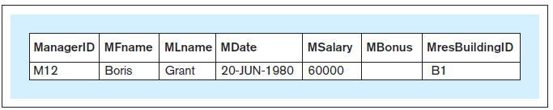
IS NULL
Query 45 text: Retrieve records for all managers who do not have a bonus
Query 45: SELECT * FROM manager WHERE mbonus IS NULL;
Query 45 result:
Notes:
This example is discussed on Page 166.

Slide 65
EXISTS
EXISTS
In queries where the inner query (nested query) uses columns from the relations listed in the SELECT part of the outer query, the inner query is referred to as a correlated subquery
In such cases, the EXISTS operator can be used to check if the result of the inner correlated query is empty

Slide 66
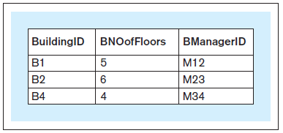
EXISTS
Query 46 text: Retrieve records for all buildings that have managers living in them
Query 46: SELECT * FROM building b WHERE EXISTS (SELECT * FROM manager m WHERE b.buildingid = m.mresbuildingid);
Query 46 result:
Notes:
This example is discussed on Page 167.

Slide 67
NOT
NOT
Can be used in conjunction with the condition comparison statements returning the Boolean values TRUE or FALSE

Slide 68
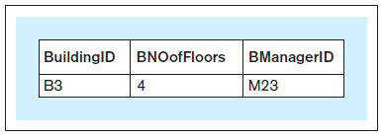
NOT
Query 47 text: Retrieve records for all buildings that do not have managers living in them
Query 47: SELECT * FROM building b WHERE NOT EXISTS (SELECT * FROM manager m WHERE b.buildingid = m.mresbuildingid);
Query 47 result:
Notes:
This example is discussed on Page 167.

Slide 69
INSERTING FROM A QUERY
Inserting from a query
A query retrieving the data from one relation can be used to populate another relation

Slide 70
INSERTING FROM A QUERY
Create Table Statement 1: CREATE TABLE cleaningdenormalized ( buildingid CHAR(3) NOT NULL, aptno CHAR(5) NOT NULL, smemberid CHAR(4) NOT NULL, smembername VARCHAR(15) NOT NULL, PRIMARY KEY (buildingid, aptno, smemberid));
Insert Statement 2:
INSERT INTO cleaningdenormalized SELECT c.buildingid, c.aptno, s.smemberid, s.smembername FROM cleaning c, staffmember s WHERE c.smemberid = s.smemberid;
Notes:
This example is discussed on Page 168.

Slide 71
INAPPROPRIATE USE OF OBSERVED VALUES IN SQL
Inappropriate use of Observed Values in SQL
A common beginner’s SQL mistake occurs when novice user creates a simplistic query that produces the correct result by inappropriately using observed values

Slide 72
SQL STANDARD AND SQL SYNTAX DIFFERENCES
SQL Standard
SQL became the standard language for querying data contained in a relational database
Notes:
SQL standard is discussed on Page 169.

Slide 73
SQL STANDARD AND SQL SYNTAX DIFFERENCES
SQL standard and SQL syntax differences
Minor SQL syntax differences exist in SQL implementations in various popular RDBMS packages, such as differences in:
DATE and TIME data types
FOREIGN KEY syntax
Usage of AS keyword with aliases
ALTER TABLE syntax
Set operators
FULL OUTER JOIN implementation
Constraint management
GROUP BY restrictions
Notes:
SQL syntax differences are discussed on Paged 170-174. The differences are minor, and a user of SQL in one RDBMS is be able to switch to another RDBMS with very little additional learning effort.

